Slide 1

NATIONAL INSTITUTE OF TECHNOLOGY KARNATAKA, SURATHKAL
Seminar on BCI and its Applications
SUBMISSION BY: | SUBMISSION TO:
SOHHAM SEAL MCA 3RD SEMESTER ROLL NUMBER: 204CA049 | Dr. CHANDHINI G. Ms. DEEPTHI L.

Slide 2

Brain-Computer Interface and its Applications
DEPARTMENT OF MACS
2

Slide 3
Contents
1.
2.
3.
Introduction
Working
Applications
4.
5.
Impact
Conclusion
What is BCI?
How does it work?
What can it be used for?
How helpful is it?
Future prospects
DEPARTMENT OF MACS
3

Slide 4
1.
Introduction
What is BCI?
DEPARTMENT OF MACS
4

Slide 5
About the Brain
Frontal Lobe
Parietal Lobe
Personality, thinking, planning, problem solving
Controls sensations (pain,taste, touch,etc.), speed and writing
Temporal Lobe
Cerebellum
Controls speech and hearing
Controls movement, balance and muscles.
Occipital Lobe
Controls memory, sight and smell
Different brain parts interact with each other through tiny electrical signals called nerve impulses
DEPARTMENT OF MACS
5

Slide 6

BCI definition
Brain–computer interfaces (BCIs) are systems that translate a measure of a user’s brain activity into messages or commands for an interactive application
DEPARTMENT OF MACS
6

Slide 7
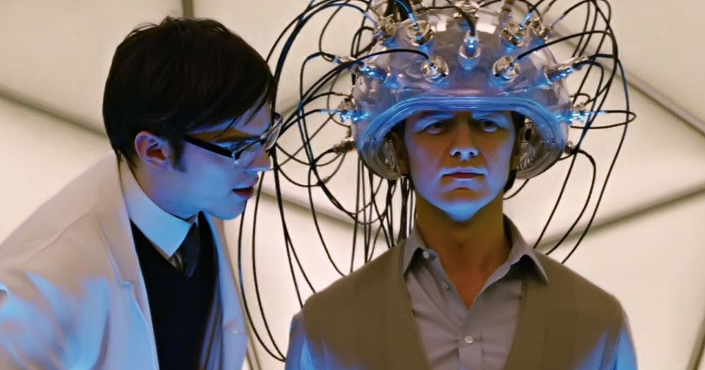

Slide 8
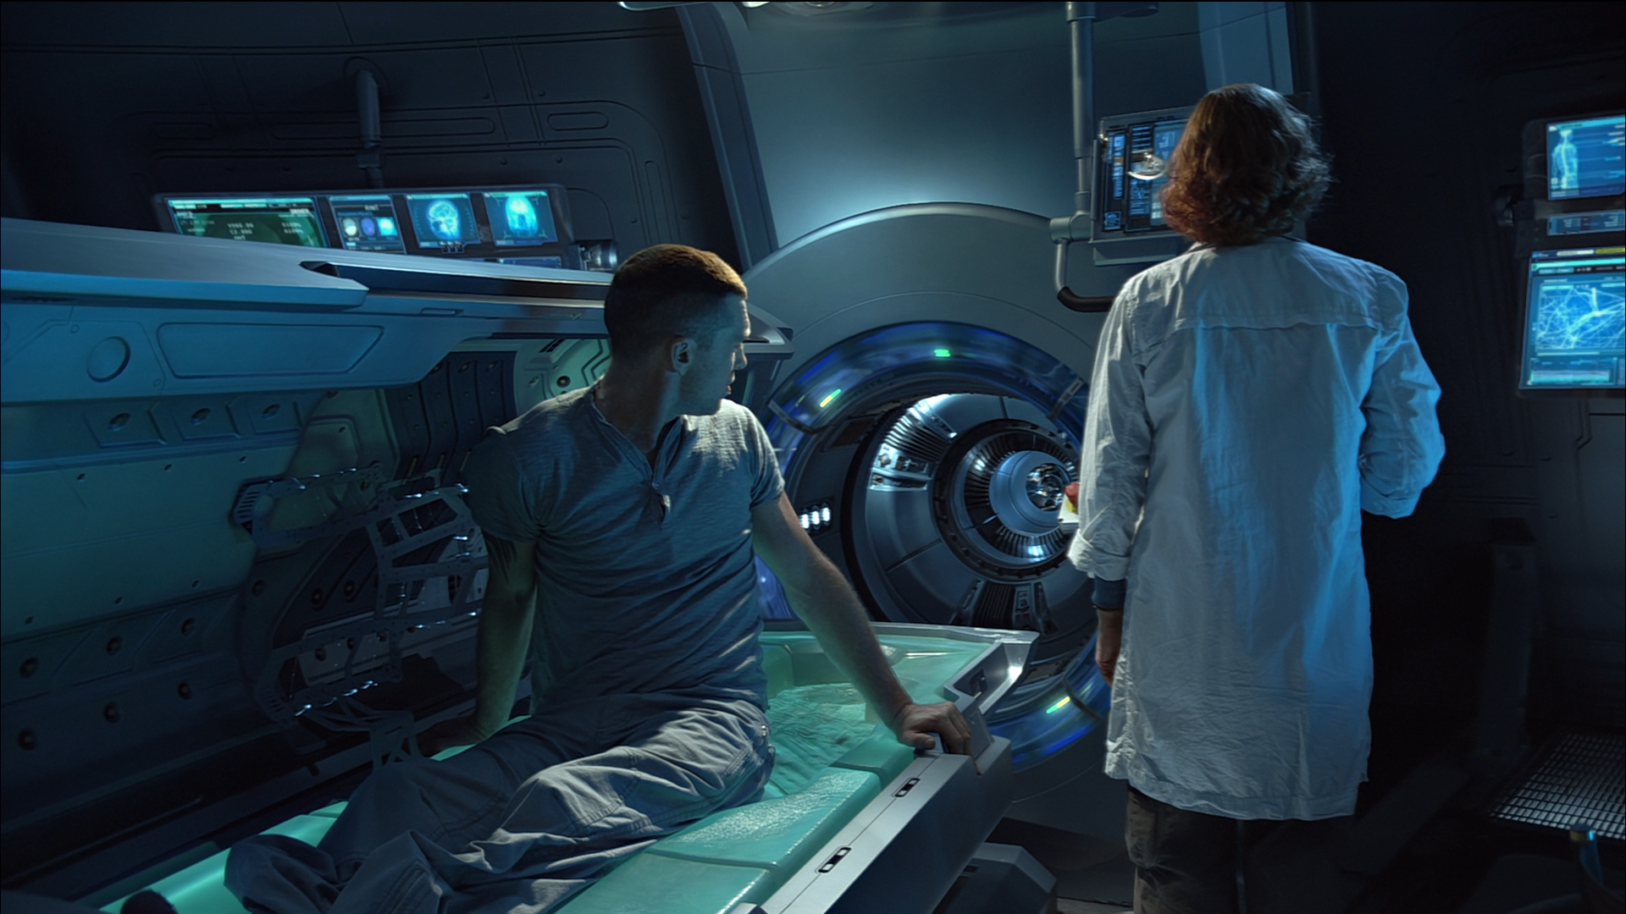

Slide 9
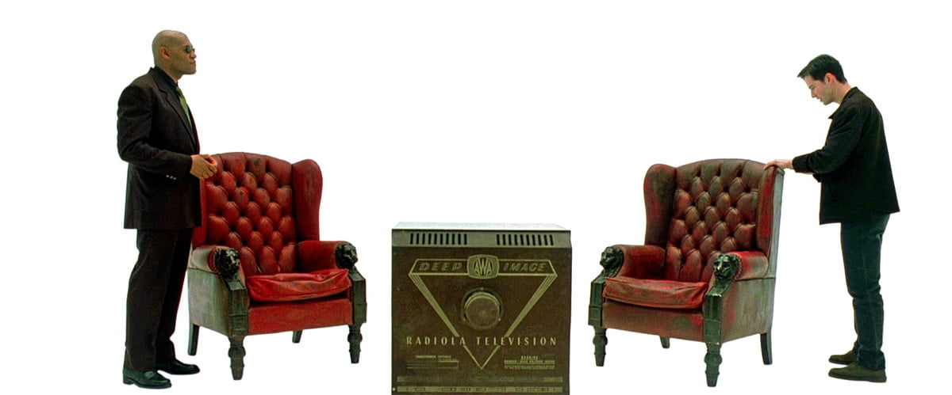

Slide 10
BCI Development Timeline
1929
1973
1990
2001
2015
First Human EEG was created by Hans Berger
J. J. Vidal coined the term Brain-Computer Interface
The first brainwave drawing game was created
Trials for invasive BCIs on primates started under Nicolelis
The International BCI Society is founded
1
2
3
4
5
P
DEPARTMENT OF MACS
10

Slide 11
2.
Working
General working of a BCI application
DEPARTMENT OF MACS
11

Slide 12
Fundamental Design
1
3
Describe the recorded and preprocessed signals
Feature Classification
Consists of device commands
Signal Acquisition
Collection of data and digitalizing it
Feature Extraction
Division into training and testing sets and machine dependent data
Result Declaration
2
4
Preprocessing
Signal Processing
DEPARTMENT OF MACS
12

Slide 13
1. Signal Acquisition Methods
1
Devices touching the scalp. E.g. EEG
2
Devices outside the cranium. E.g. MEG, fMRI
Non-Invasive
(No surgery is required)
Recording methods
3
Electrocochleography (ECoG)
Partially & Fully Invasive
4
Intracortical neuronal recording
(Surgery is required)
DEPARTMENT OF MACS
13

Slide 14
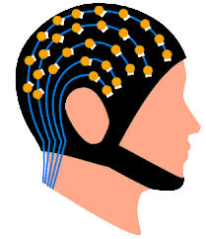
Electroencephalography (EEG)
NON-INVASIVE
Headset with electrodes
Disadvantages
Records electrical activity on the scalp that has been shown to represent the macroscopic activity of the surface layer of the brain underneath
Susceptible to noise
Cranial barrier dampens the incoming signal
Application of gel might be necessary
DEPARTMENT OF MACS
14

Slide 15
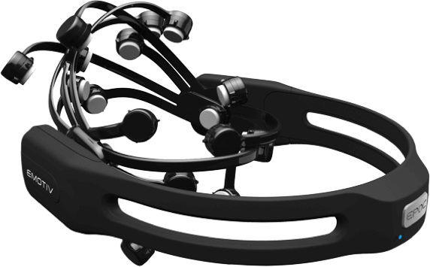
EMOTIV
EPOC 3 Quarters
High Resolution, wireless neuroheadset.
Connects wirelessly to PC with Windows, Linux or Mac OS.
Mainly used to control a computer using facial expressions and thoughts.

Slide 16
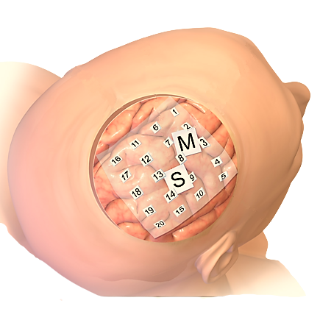
PARTIALLY INVASIVE
Electrocorticography (ECoG)
Intracranial Electrode Grid
Embedded stretchable organic electrodes
Hydrogel substrate
Soft and stable adhesion to brain
Permeable to body fluids for long-term use
DEPARTMENT OF MACS
16

Slide 17
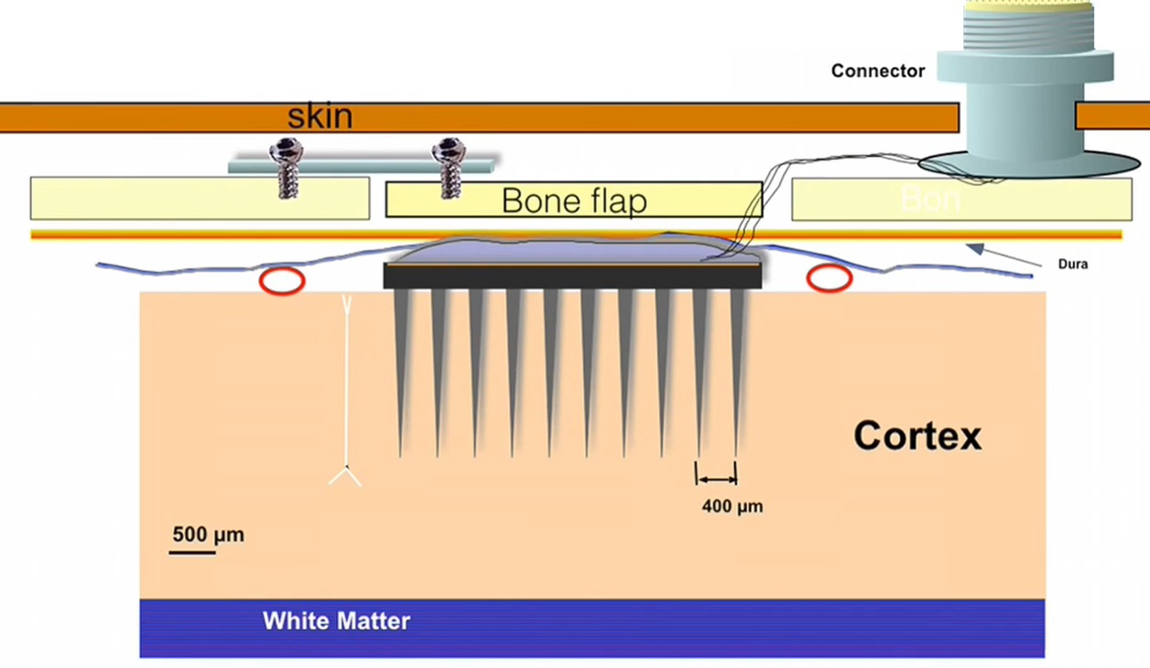
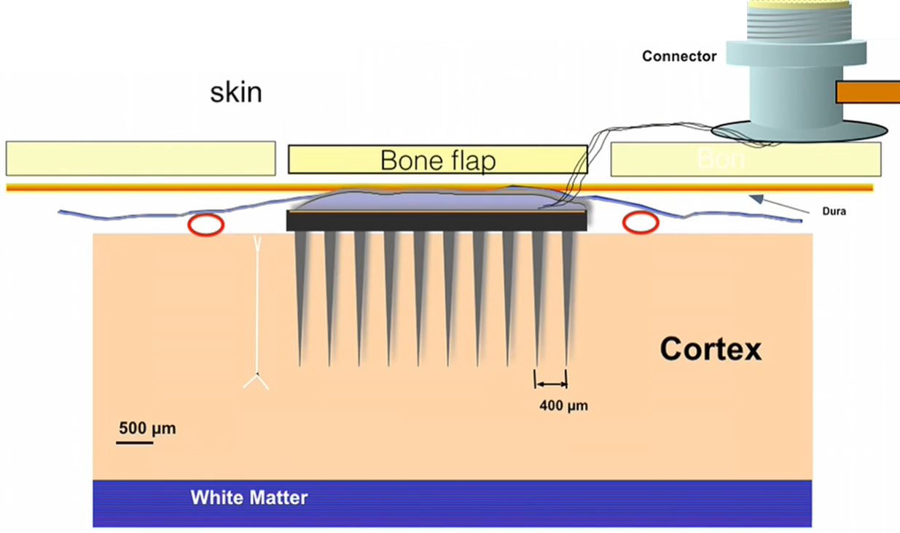
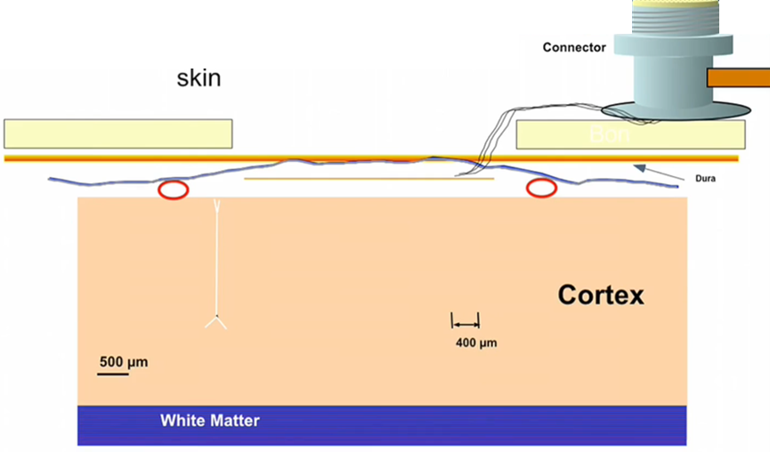
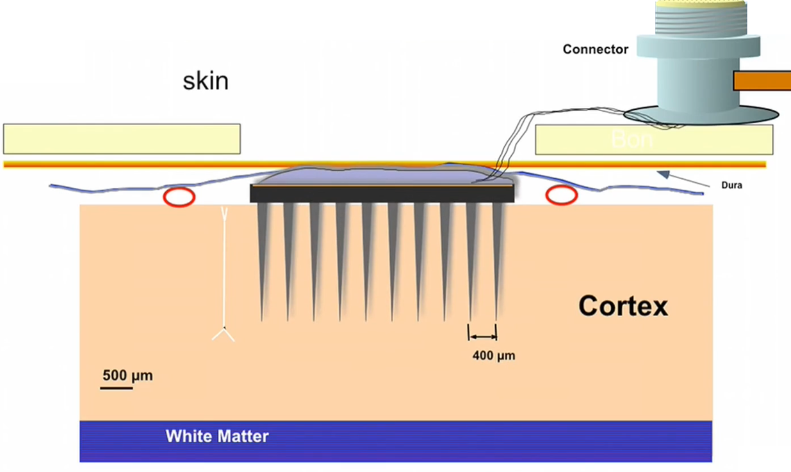
INVASIVE
Intracortical Microelectrode
DEPARTMENT OF MACS
17

Slide 18
{1-2}. Preprocessing
Once the EEG signals are acquired they are preprocessed to de-noise the recorded data, to enhance the information specific brain activity patterns
Physiological Artifacts
Non-Physiological Artifacts
Caused by peripheral electrical and muscular activities.
For e.g.-
Unintentional eye blink or movement,
Muscle movements near the device,
Pulse, sweat, etc.
Caused by interference due to electromagnetic sources.
For e.g.-
Powerline interference,
Movement of electrodes,
Low battery, etc.
DEPARTMENT OF MACS
18

Slide 19
2. Feature Extraction
Feature extraction is the process to describe the recorded and preprocessed brain signals using a compact and relevant signal values known as features.
1
2
3
4
Time Domain | Frequency Domain | Time -Frequency Domain | Spatial Domain
Signal analysis based on time duration-related information | Signal of trigo waves of different frequencies | Signal possess time & frequency properties | Signals to identify specific brain regions
DEPARTMENT OF MACS
19

Slide 20
3. Feature Classification Methods
These methods aims at automatically determining a user’s intention by classifying extracted brain features
1
2
3
4
5
Linear Classifiers
Neural Networks
Non-linear Bayesian
Nearest Neighbour
Combined Classifiers
Most popular algos. For e.g.: LDA and SVM
For e.g.: NNs like MLP, etc.
Not fast enough. For e.g.: HMM, etc.
Relatively simple algos. For e.g.: kNN, etc.
Recent trend of using multiple algos at a time
DEPARTMENT OF MACS
20

Slide 21
3.
Applications
Where we can apply BCIs
DEPARTMENT OF MACS
21

Slide 22
Clinical & Healthcare
Preventive
Diagnostic
Rehabilitative
Assistive
1
2
Cognitive state monitoring, addiction
Tumours, brain diseases, sleep disorders
3
4
Brain-stroke, psychological disorders
Neuro-prosthetics, communication
Notes:
CLIS, LIS, ALS, partially disabled

Slide 23
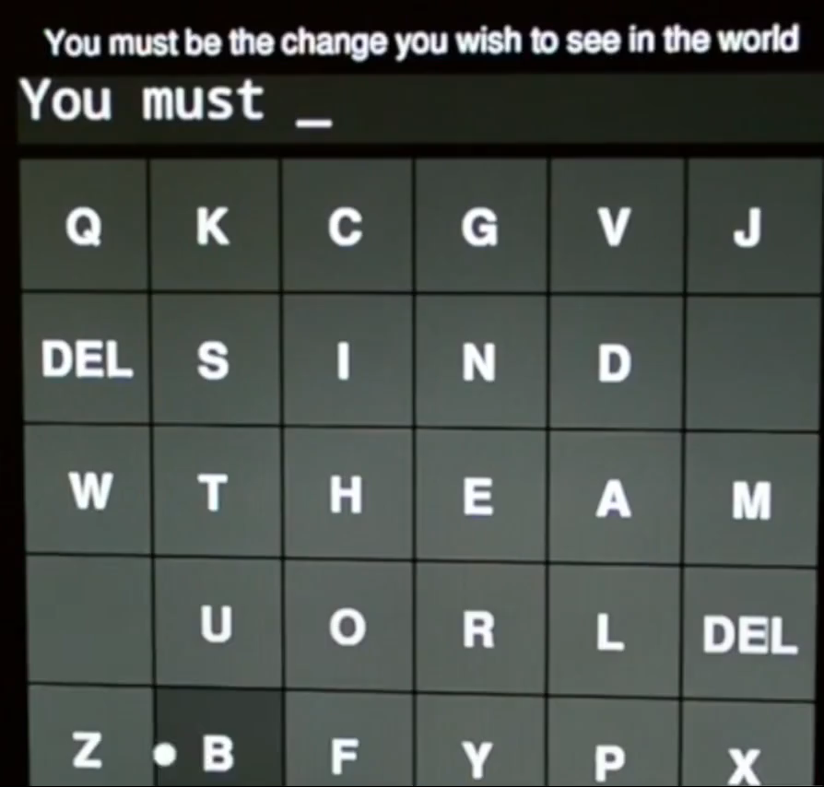
P300 Speller
Constructed for patients who are unable to communicate with their surroundings because of a combined phatic disorder.
Crucial for patients with CLIS, LIS, ALS or partial disability
DEPARTMENT OF MACS
23

Slide 24
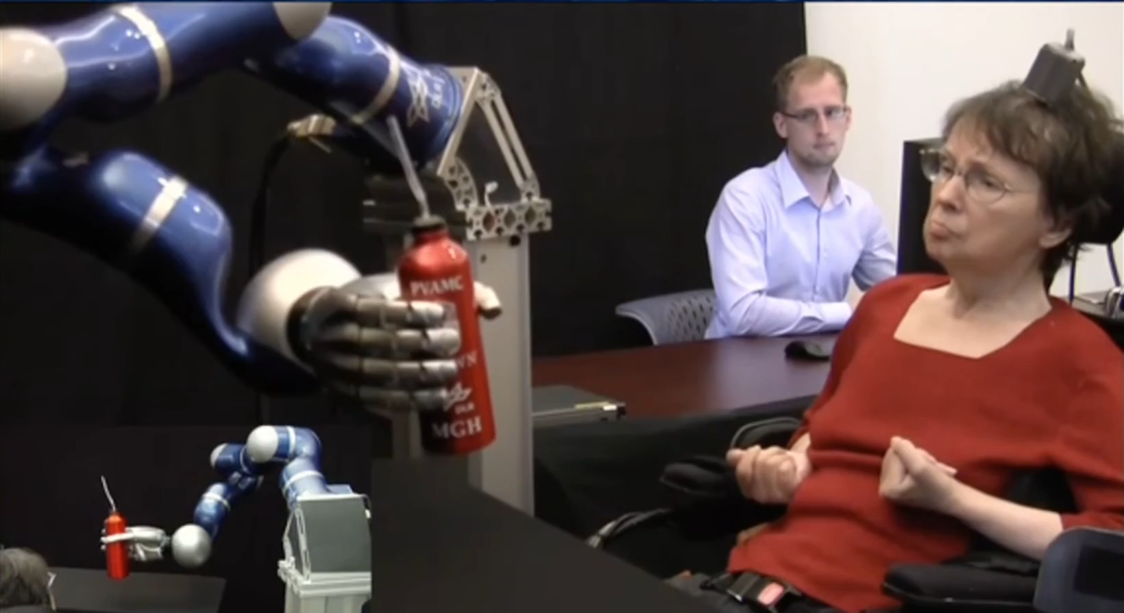
Notes:
Virtual Limb

Slide 25
Non-Clinical Applications
Security | Environment Control
Entertainment | Games
Neuromarketing | Neuro-ergonomics
Artistic creations | Education and Learning
DEPARTMENT OF MACS
25

Slide 26
A few more …
Bionic eye
Cochlear implant
Monitoring Alertness
Navigating Virtual Worlds
Lie Detection and Applications in Law
Estimating Cognitive Load
Robotic Avatars
DEPARTMENT OF MACS
26

Slide 27
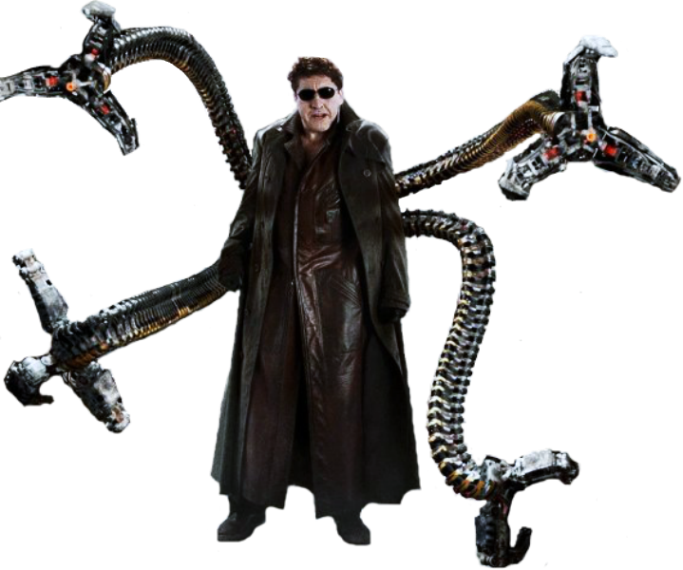

DEPARTMENT OF MACS
27

Slide 28
4.
Impact
Market analysis and usefulness
DEPARTMENT OF MACS
28

Slide 29
Global BCI market analysis
North America
It has become the highest revenue generating region in 2020 with more usage in BCI hardware than in BCI software
DEPARTMENT OF MACS
29

Slide 30
$5,463 million
Global Brain Computer Interface market is expected to reach
by 2030
Growing at a CAGR of 13.9%
DEPARTMENT OF MACS
30

Slide 31
Benefits
Drawbacks
CLIS, LIS, ALS patients have greater scope of communication and interaction
More interesting controls in games
Physically disabled people can benefit
Telepresence
Non-invasive methods have less accuracy
Invasive methods might scar brain tissues
Inaccuracy
Lack of security
DEPARTMENT OF MACS
31

Slide 32
5.
Conclusion
Future prospects…
DEPARTMENT OF MACS
32

Slide 33
The technology of the BCI system is a relatively new multi-disciplinary research area,
Helpful with permanent neurological disorders,
Although it is mainly used as a gaming control, it has a high potential of helping people in need,
With new advancements, it is going to steadily gain importance.
DEPARTMENT OF MACS
33

Slide 34
REFERENCES
Lotte F., Congedo M., Lécuyer A., Lamarche F., Arnaldi B. (2007). A review of classification algorithms for EEG-based brain–computer interfaces. Journal of Neural Engineering.
Nam C., Nijholt A., Lotte F. (2018). Brain-Computer Interfaces Handbook: Technologies & theoretical advances. CRC Press.
Rao R. (2013). Brain-Computer Interfacing: An Introduction. Cambridge University Press.
Bansal D., Mahajan R. (2019). EEG-Based Brain-Computer Interfaces: Cognitive Analysis and Control Applications. Academic Press.
Gandhi V. (2015). Brain-Computer Interfacing for Assistive Robotics: Electroencephalograms, Recurrent Quantum Neural Networks and User-Centric Graphical Interfaces. Academic Press.
Friedrich O., Racine E., Steinert S., Pömsl J., Jox R. (2021). An analysis of the Impact of Brain-Computer Interfaces on Autonomy. Springer Nature.
DEPARTMENT OF MACS
34

Slide 35
Thanks!
Any questions??
DEPARTMENT OF MACS
35

